Slide 1

Software Engineering
Tenth Edition
Chapter 23
Project planning
Copyright © 2016, 2011, 2006 Pearson Education, Inc. All Rights Reserved
Notes:
If this PowerPoint presentation contains mathematical equations, you may need to check that your computer has the following installed:
1) MathType Plugin
2) Math Player (free versions available)
3) NVDA Reader (free versions available)

Slide 2

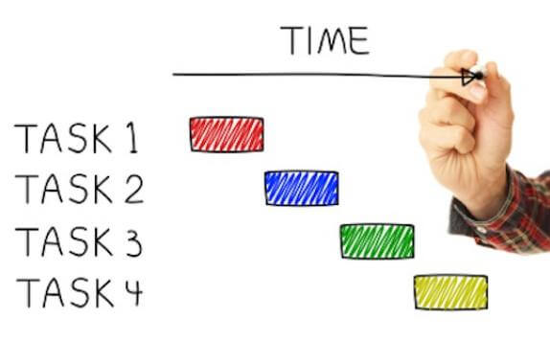
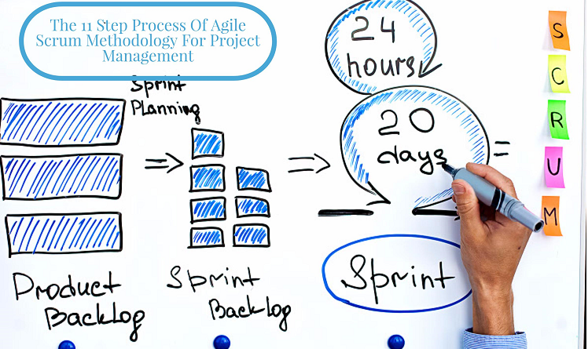
Learning Objectives
Project Planning
Project scheduling
Agile planning

Slide 3
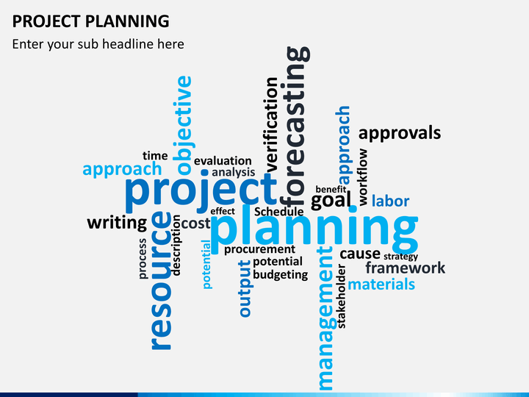
Project Planning

Slide 4
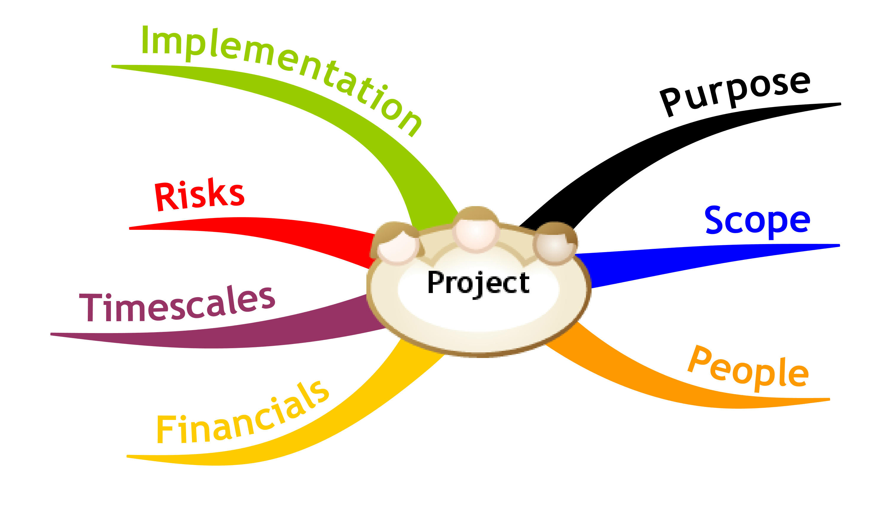
Project Planning(What)
breaking down
Project planning involves ______________the work into parts and assign these to _____________________, anticipate problems that might arise and prepare tentative __________ to those problems.
project team members
solutions

Slide 5
Planning Stages
During the project startup phase, when you have to plan
Staff: who will work on the project,
Tasks: how the project will be broken down into increments,
Resources: how resources will be allocated across your company, etc.

Slide 6
Project Startup Planning
1 System requirements
At this stage, you know more about the system requirements but do not have design or implementation information
Create a plan with enough detail to make decisions about the project budget and staffing.
This plan is the basis for project resource allocation
2 Budget and staffing

Slide 7
Project Startup Planning Cont..
3 Project monitoring
The startup plan should also define project monitoring mechanisms
A startup plan is still needed for agile development to allow resources to be allocated to the project
4 Needed for agile

Slide 8
Work/Development Planning
The project plan should be regularly amended as the project progresses and you know more about the software and its development
The project schedule, cost-estimate and risks have to be regularly revised
1 Project
plan
2 Project schedule

